Slide 1
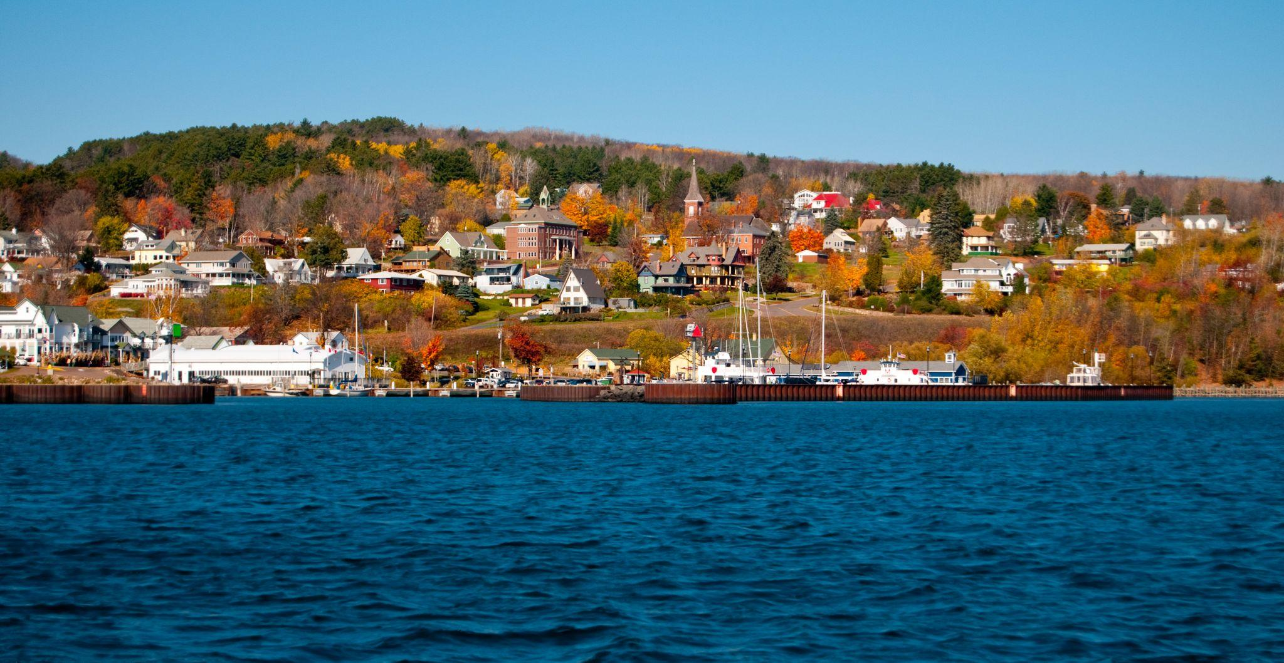

Rural Affordable Workforce Housing Pilot Concept Feedback Session

Slide 2

Agenda
Welcome
Opening Remarks
Rural Housing Pilot Overview
Concept Presentations
Closing Remarks

Slide 3

Welcome and Opening Remarks
Elmer Moore
CEO and Executive Director, WHEDA
Kellie Pederson
Community Development Educator, UW-Madison Division of Extension/Bayfield County
Rebecca Giroux
Community & Economic Development Officer, WHEDA

Slide 4


Opening Question:
Notes:
If any part of this needs legislation to change/remove/add to current law, remember to identify and work with any groups who may be opposed. Realtors should be at the top of that list. Anything that limits the sale or uses of property will be challenged.

Slide 5
Rural Affordable Workforce Housing Pilot
A community-based piloting process to inform and address workforce housing disparities in rural communities across the state.
Part of WHEDA’s larger Rural Affordable Workforce Housing Initiative
Three pilot communities were selected in rural Wisconsin
Roughly an 8-month pilot design process designed with three phases
There’s no silver bullet
Working as close to the local challenge as possible

Slide 6
Meet the Design Team
Kellie Pederson
Community Development Educator, UW - Extension
Mark Abeles-Allison
County Administrator,
Bayfield County
Ray DePerry
Executive Director,
Red Cliff Housing Authority
Gordon Ringberg
Mayor, City of Bayfield
Steven Wiley
Planning and Development Director, City of Ashland
Jennifer Toribio-Warren
Executive Director,
Bad River Housing Authority
Karen Novachek
City Council, City of Washburn
Jeff Silbert
Board of Supervisors,
Bayfield County
Brant Kucera
Administrator,
City of Ashland
Cole Rabska
Executive Director,
Bayfield County EDC
Heidi Zimmer
President, Zimmer Development Owner, Wild Rice Retreat
Sheldon Johnson
Executive Director, Northwest Wisconsin Regional Planning Commission
David Popelka
Supervisor, Town of Cable
Michael Kuchta
Administrator, Town of La Pointe

Slide 7
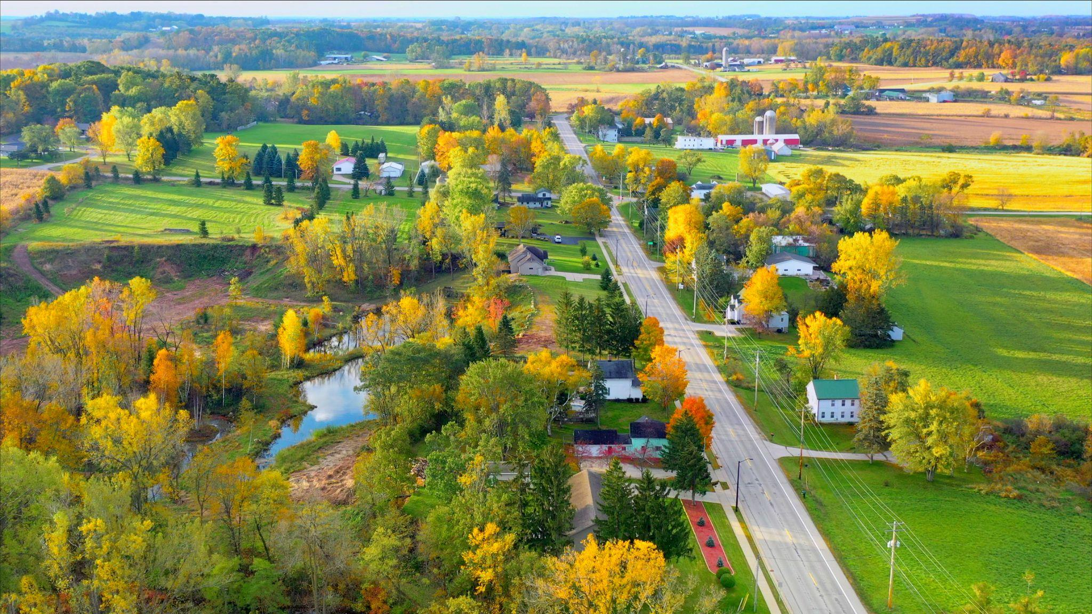
Rural Affordable Workforce Housing Pilot
Goal
Create new solutions to increase rural workforce affordable housing
Objectives
Build a series of pilots for the Chequamegon Bay Region
Use what is learned to guide statewide strategies

Slide 8
Rural Affordable Workforce Housing Pilot
What is affordable housing in the Chequamegon Bay Area?
Housing which individuals/families can rent or purchase for no more than 30% of gross household income, exclusive of other debt.
What is Workforce Housing? ​
Loosely defined as housing affordable to those earning 60-120% of median household income (also called Area or County Median Income or AMI/CMI)
Bayfield County: $34,354-$68,708
Ashland County: $28,721-$57,443
2 person household ranges: $38,580-$77,162
4 person household ranges: $48,180-$96,362

Slide 9
Rural Affordable Workforce Housing Pilot
How can the Chequamegon Bay region create and preserve quality, affordable places for workforce households to live and thrive?

Slide 10
Pilot Concepts
Representatives of the pilot design team will present three concepts for your feedback.
During the presentation, you can submit questions for the design team members. We will try our best to get through 1-2 questions per team, dependent on time.
After each presentation, we will have 2 polling questions.
If you are attending via phone, you can email your responses to ruralaffordablehousing@wheda.com
At the conclusion of this event, we will email out a survey link for a short, 2–3-minute survey.
Your feedback is very important to the design process.

Slide 11
Concepts Presented
Transforming Zoning
Encouraging Small-Scale Housing Developments in Rural Communities
Buy Out, Buy In (BOBI) Homeownership Program

Slide 12
Pilot Concept #1:
Transforming Zoning
Mark Abeles-Allison
County Administrator, Bayfield County
Gordon Ringberg
Mayor, City of Bayfield
Karen Novachek
City Council, City of Washburn
Jeff Silbert
Board of Supervisors, Bayfield County
Heidi Zimmer
President, Zimmer Development
Owner, Wild Rice Retreat
David Popelka
Supervisor, Town of Cable
Steven Wiley
Planning and Development Director,
City of Ashland

Slide 13
Pilot Concept #1: Transforming Zoning
\
What is Zoning?
→ Zoning is the way communities guide the physical development of land and the kinds of uses allowed.
→ Zoning is the process of dividing land into separate districts/zones, with differing regulations
→ Zoning ordinances can determine many factors including lot size, density, building height, etc.
→ Zoning helps communities achieve comprehensive planning goals and is a tool to promote orderly and consistent development.

Slide 14
Pilot Concept #1: Transforming Zoning
\
What is the challenge we are solving for? While Zoning is a tool…
Zoning can impact development and the cost of homes. For example:
In Bayfield County, zoning requires a certain amount of open space per dwelling unit.
Current zoning in Bayfield County limits mixed use and high density developments.
In Addition: Zoning ordinances:
Can be complex, outdated, and difficult to interpret
May not not accommodate new trends or technologies associated with affordable single and multi-family housing units needed.
Developed years ago, may not be consistent with today’s workforce housing goals.

Slide 15

Transforming Zoning
\
Who zones in our communities?
Many municipalities have their own zoning.
Ashland and Bayfield County zoning applies to most towns.
Tribal zoning directs tribal land use.
Future land use and Comprehensive Plans guide zoning ordinances.
Notes:
Affordable housing will look different in every community. Some communities could be harmed by a single-site development that could be seen as the “poor part of town.” I well remember the “projects” as a kid in Cleveland. If you lived there, you were dirt.
A different community could accept and appreciate Accessory Dwelling Units, where the site of a single home can accommodate another house or two. Certain neighborhoods with large lot sizes may be suitable for this concept, with local approval.

Slide 16
Transforming Zoning
\
What are the top issues we want to address with this pilot?
Identify zoning codes that may limit housing development and unnecessarily add to home construction cost. This may include:
  Density constraints that limit ability to build cost effectively
  Codes that are difficult to understand creating unnecessary barriers to development
Assist communities with limited resources to address zoning impacts on housing.

Slide 17

Transforming Zoning
\
Final SLide
What is this concept and what does it do?
The TRANSFORMING ZONING concept proposes to:
Hire a professional zoning consultant to review existing zoning ordinances and recommend (to entities wishing to participate) zoning amendments that support housing development.
Encourage communities to consider principles and policies that help communities achieve housing goals.

Slide 18
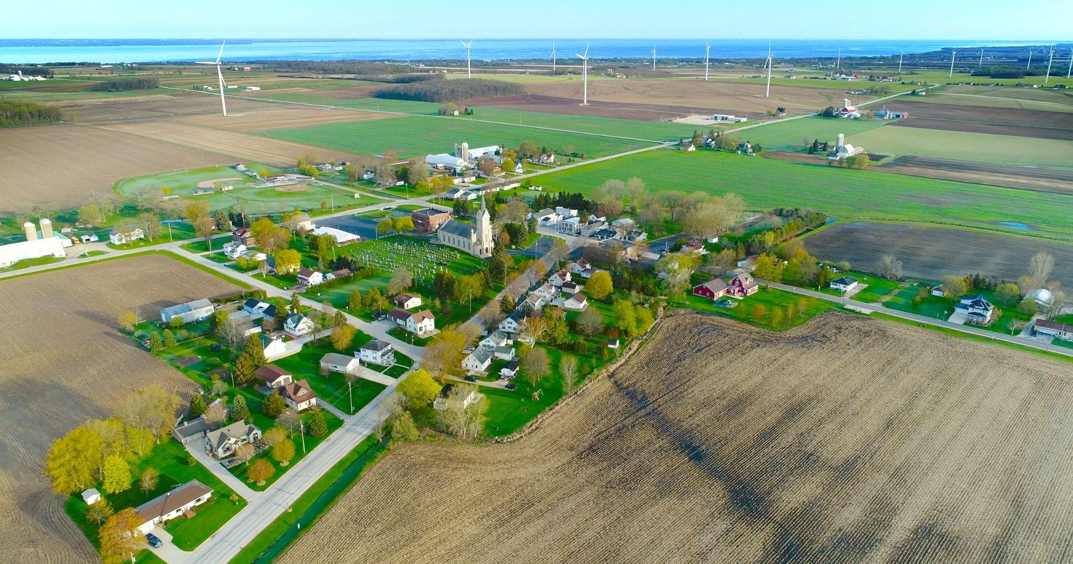
Transforming Zoning
\
What partners and/or funders are needed?
Public and Private Involvement is Critical
County Boards
Cities, Villages, Towns
Red Cliff and Bad River Bands of Lake Superior Chippewa
Economic Development Agencies
Housing Developers
Regional Planning Commission
WHEDA and other state agencies

Slide 19
Transforming Zoning
\
What other resources can be used to implement this solution:
Local Facilitation through UWEX, NWRPC, Planning and Zoning Depts.
WHEDA
Collaborative Local Financial Support
State and regional grants, ie: Coastal Management, CDGB, DNR, etc.
Notes:
Check in with League of Municipalities, Counties Association, and Towns Association. They will have histories of attempts, failures, and successes of changing zoning to encourage housing development.

Slide 20
Transforming Zoning
\
What do we need to get this done?
Local Governmental approval to participate. Collaboration and acknowledgement of the impact updated zoning may have on encouraging housing development.
Gather zoning codes of participating entities.
Jointly develop and solicit proposals and designate lead agency.
Hire firm to:
  Review existing zoning codes, make recommendations on focus areas for each entity
  Produce developer and builder tools to allow quick maneuvering of zoning processes.
  Talk with local units of government on anticipated impact of changes.
  Acknowledge individual community preference and planning goals.
PILOT to assist with consultant hire and provide participating entities up to $2000 each to notice, advertise and implement housing ordinance amendments and engage communities.
Consider a 10% local cost to participate, to ensure local buy in.
Notes:
We will also need to consider all the ramifications of undeveloped land, with no water, electricity, gas lines, sewers or internet. Two tracks, perhaps?

Slide 21
Concept #1: Your feedback is needed
Notes:
If any part of this needs legislation to change/remove/add to current law, remember to identify and work with any groups who may be opposed. Realtors should be at the top of that list. Anything that limits the sale or uses of property will be challenged.

Slide 22
Pilot Concept #2:
Encouraging Small-Scale Housing Developments in Rural Communities
Cole Rabska
Executive Director, Bayfield County EDC
Kellie Pederson
Community Development Educator,
UW - Extension
David Popelka
Supervisor, Town of Cable
Ray DePerry
Executive Director, Red Cliff Housing Authority
Michael Kuchta
Administrator, Town of La Pointe

Slide 23
Pilot Concept #2: Encouraging Small-Scale Housing Developments in Rural Communities
\
What are the challenge we are solving for? What issues will this pilot solve?
Rural areas have limited capacity to initiate development. Historically, this has not been a role of rural government.
Funding resources tend to favor large developments. However, large developments are not necessarily viable in most rural communities.
Currently, there are limited funding programs that support households making 60-120% of the median income. However, these residents are critical to the function of our communities and they are in dire need of housing options.
Currently there are limited subsidies available for developers interested in developing small affordable housing developments.
Notes:
Small rural communities are having a difficult time accessing and incentivizing small-scale developments to meet their needs
Lack of profitability for local and regional developers to build workforce housing (60%-120% CMI)
Lack of mechanisms to support affordable homeownership and rental opportunities for households 60%-120% CMI
The “affordable housing development industrial complex” favors BIG DEVELOPERS doing BIG PROJECTS
Lack of support and subsidy for small developers and small developments (4-12) in small communities (less than 1500 people)

Slide 24
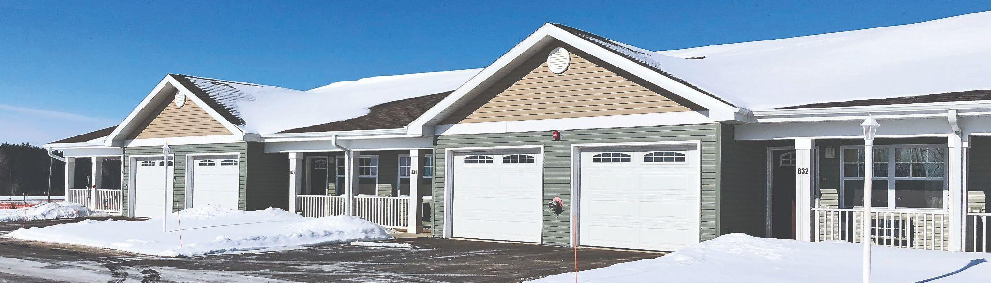
Pilot Concept #2: Encouraging Small-Scale Housing Developments in Rural Communities
\
What is this concept?
This concept has two primary components:
Building capacity in rural communities to initiate and support Small-Scale Housing Development projects
Creating new funding resources for local or regional developers to build housing in rural communities that can be purchased or rented by residents making 60%-120% of County Median Income
  In Bayfield and Ashland Counties this translates to households making approximately $28,721 - $96,362 gross income annually (1-4 person HH)
Notes:
Around $14 per hour is equal to the $29,000 per year 60% income.
On this document, Bayfield and Ashland counties are the same and can be found towards the bottom of the document as a non-metro county. (Set by HUD)
60% - 2 person HH: $38,580
60% - 4 person HH: $48,180
80% - 2 person HH: $51,442
80% - 4 person HH: $64,240
100% - 2 person HH: $64,300
100% - 4 person HH: $80,300
120%- 2 person HH: $77,162
120% - 4 person HH: $96,362
Hourly Rate Ashland
60% - $13.81
80% - $18.41
100% - 23.00
120% - $27.62
Hourly Rate Bayfield County
60% - $16.52
80%- $22.02
100%- $27.53
120% - $33.03

Slide 25
Pilot Concept #2: Encouraging Small-Scale Housing Developments in Rural Communities
\
How much money does the 60%-%120 actually mean.
In Bayfield and Ashland Counties this translates to single person households making approximately $28,721 - $68,708 gross
Taking an average of the two counties CMI the following numbers are an average hourly wage needed to reach the % level.
  60% - $15.17
  80% - $20.22
  100% - $25.27
  120% - $30.33
Notes:
Around $14 per hour is equal to the $29,000 per year 60% income.
On this document, Bayfield and Ashland counties are the same and can be found towards the bottom of the document as a non-metro county. (Set by HUD)
60% - 2 person HH: $38,580
60% - 4 person HH: $48,180
80% - 2 person HH: $51,442
80% - 4 person HH: $64,240
100% - 2 person HH: $64,300
100% - 4 person HH: $80,300
120%- 2 person HH: $77,162
120% - 4 person HH: $96,362
Hourly Rate Ashland
60% - $13.81
80% - $18.41
100% - 23.00
120% - $27.62
Hourly Rate Bayfield County
60% - $16.52
80%- $22.02
100%- $27.53
120% - $33.03

Slide 26
Pilot Concept #2: Encouraging Small-Scale Housing Developments in Rural Communities
\
Component 1: Building capacity in rural communities to initiate Small-Scale Housing Development projects.
This component will provide support for communities to work through a step-by-step process to:
  Clearly articulate community housing needs and wants
  Identify land suitable for development of 2-12 homes
  Identify incentives for development
  Develop and issue Request for Proposals (RFP) in accordance with community needs and wants
  Support transparent selection process to identify viable proposals
  Work with selected developers and communities to create
  developer agreement to carry out project
Notes:
2-12 homes could include duplex or four plex-not necessarily 12 single family homes in one location

Slide 27
Pilot Concept #2: Encouraging Small-Scale Housing Developments in Rural Communities
\
Component 1: Building capacity in rural communities to initiate Small-Scale Housing Development projects
What resources do we need to get this done?
A component of this project will be supported by an innovative partnership between UW-Extension and Bayfield County. These two entities have been working together to create a Housing Outreach Specialist to support communities in this way.
  The anticipated start date of this Housing Outreach Specialist position is January 1, 2023. Isn’t it great that this is already in place?!
Local support from the counties, municipalities, and Tribal partners.
Support from WHEDA and other statewide partners.
Notes:
Position has been established in cooperation/coordination with the UW-Extension office and Bayfield County Government.

Slide 28
Pilot Concept #2: Encouraging Small-Scale Housing Developments in Rural Communities
\
Fun Fact: Half of Wisconsin communities
have fewer than 1,500 residents!
Component 2: Creating new funding resources for local and regional developers to build housing in rural communities
How does it work? Part A
Provide a 2% interest only / 36-month construction loan program for “qualified developers” to develop 2-12 “affordable” units in “qualified communities” when the units are offered at an “income qualified price” and sold/rented to an “income qualified buyer”
  Qualified community
    Less than 2,500 residents with land available for development (does not have to be community-owned)
  Qualified developer
    Capacity to effectively manage and complete project scope
Notes:
ONLY an IDEA. There would be a lot of working parts with attorney’s to further this agenda.
2 parts to the process.
Part A:2% interest loan to the developer.
Part B: Purchase price subsidy when units are sold to qualified buyers

Slide 29
Pilot Concept #2: Encouraging Small-Scale Housing Developments in Rural Communities
\
Component 2: Creating new funding resources for local and regional developers to build housing in rural communities
How does it work? Part B
Provide an additional purchase price subsidy to developer when the units are offered at an “income qualified price” and sold/rented to an “income qualified buyers/renters”
  “Income-qualified price”
    a price that ensures income qualified buyers/renters are able to afford the home
    homes would be deed restricted so that the property would
remain affordable long-term
Notes:
Deed Restriction thoughts:
% of income limited on the original purchase price of home. Anything over that would revert back to the loan/subsidy program
Homes would have to be sold at or below original purchase price by the homeowner to another qualified home buyer

Slide 30
Pilot Concept #2: Encouraging Small-Scale Housing Developments in Rural Communities
\
Component 2: Creating new funding resources for local, regional developers to build housing in rural communities
How does it work? Part B (cont’d)
  “Income qualified buyer/renters”
    A buyer with a household income within 60%-120% of the
    County Median Income
  A “purchase price subsidy”
    A subsidy that aims to eliminate the gap between the cost of development and what “income qualified” buyers/renters can afford.
    This is a one time-upfront subsidy to the developer, rather than an ongoing subsidy to the owner or renter
Notes:
Hourly Rate Ashland
60% - $13.81
80% - $18.41
100% - 23.00
120% - $27.62
Hourly Rate Bayfield County
60% - $16.52
80%- $22.02
100%- $27.53
120% - $33.03

Slide 31
Pilot Concept #2: Encouraging Small-Scale Housing Developments in Rural Communities
\
What partners and funders are needed?
Communities interested in affordable housing development
Developers interested in working in small rural communities
Community Development Financial Institution (CDFI) or other financial institution willing to underwrite 2% loan program
Federal, State or Tribal partnering agency willing to fund (via granting program) purchase price subsidy
Community-based or Employer-based fund to support purchase price subsidy program
Other partners and agencies to support community capacity building component

Slide 32
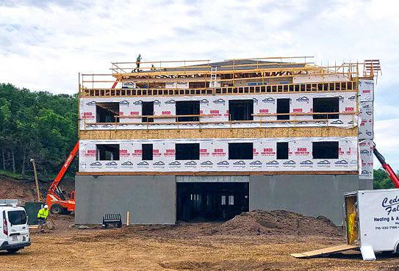
Pilot Concept #2: Encouraging Small-Scale Housing Developments in Rural Communities
\
What key first steps would be needed to enact this solution?
Perform a detailed financial analysis of program details to solidify qualifications for communities, developers, and homebuyers
Work with WHEDA, regional CDFIs, and other partners to develop extremely-low-interest loan program for developers
Identify agencies with suitable existing programs or be willing to expand existing programs to provide purchase price subsidy
Work with regional employers and other partners to develop purchase price subsidy that would serve their residents

Slide 33
Concept #2: Your feedback is needed

Slide 34
Pilot Concept #3:
Buy-Out,Buy-In
(BOBI)
Home Fund
Kellie Pederson
Community Development Educator, UW - Extension
Jennifer Toribio-Warren
Executive Director, Bad River Housing Authority
Brant Kucera
Administrator, City of Ashland
Sheldon Johnson
Executive Director, Northwest Wisconsin Regional Planning Commission

Slide 35
Pilot Concept #3: Buy-Out, Buy-In Home Fund
\
What is the challenge we are solving for?
Rising costs in the housing market have made home ownership for working families nearly unattainable.
In this “hot market” working families looking to purchase homes cannot compete with the pace of cash offers.
Fewer housing options exist for working families as homes across the region are “lost” to the short-term rental market and second home market

Slide 36
Pilot Concept #3: Buy-Out, Buy-In Home Fund
\
What is the challenge we are solving for?
Local data shows that over the next 5 years, we will see a significant number of homes entering the market as seniors across the region downsize.
  Without intervention, many of these homes will most likely become second homes, further exacerbating regional workforce challenges.

Slide 37

Buy-Out, Buy-In Home Fund
\
What does this Pilot do?
The BOBI Home Fund will acquire homes and subsidize the sale of these homes to working families.

Slide 38
Buy-Out, Buy-In Home Fund
\
Home Acquisition Opportunities:
Work with current homeowners interested in selling/downsizing
  These homes could be donated, or purchased at or below market rate to the BOBI Home Fund
Work with municipal partners to capture tax-delinquent properties
  Repair homes as needed
  Convert homes to duplex/triplex where feasible
Notes:
501c3 possible to give donors a tax incentive?
Identify owners of vacant/derelict/con-compliant properties.

Slide 39
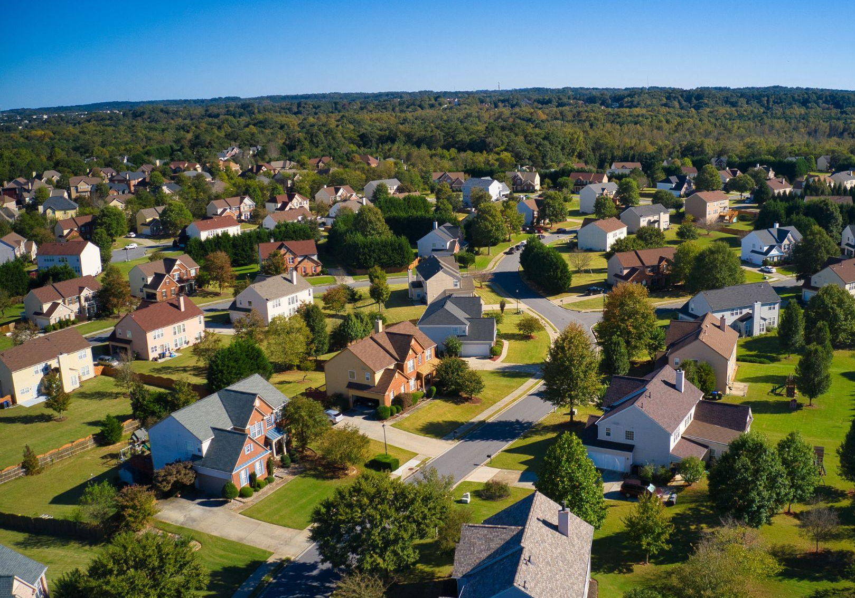
Buy-Out, Buy-In Home Fund
\
Home Ownership Model:
Income qualified-buyers (local residents making 60%-120% of Median Income) would enroll in the BOBI program
BOBI homes would be sold to these income-qualified buyers at a subsidized rate, based on income
  Income qualified-buyers would purchase homes use existing low-interest, mortgage products

Slide 40
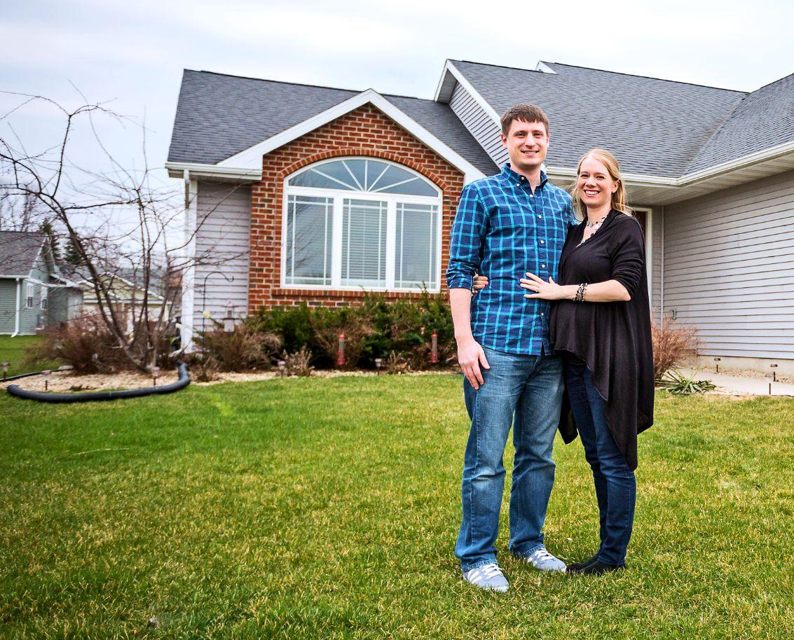
Buy-Out, Buy-In Home Fund
\
Mechanics of the BOBI Home Fund:
The fund will be generated and maintained through charitable gifts, grant dollars and matching funding from state and federal agencies.
Based on the land trust model, BOBI homes would be deed-restricted, to maintain long-term affordability.
BOBI Homeowners needing to sell their homes, would sell them back to the program with limited-equity gains. (Approx 2% annually)
Notes:
Subsidy could also come from employers who want to incentivize new employees and current workers.
As stated above, the concept of equity - and the social value of building wealth through home ownership - need to be re-imagined and fully understood.
Truly, at the heart of this model is a solid “but for”....but for this program, buyers would be excluded from ownership at all. This option is a middle ground between renting (no equity) and conventional ownership (some day I’ll own this house and sell it for a great profit.) With BOBI you will own a home, and upon selling it, end up far better off than if you had rented.

Slide 41
Buy-Out, Buy-In Home Fund
\
EXAMPLE SCENARIO:
HomeDonor A is preparing to downsize from her 3BR/2BA home. She is concerned about the housing challenges in the community and has decided she’d like to support the BOBI program. While she doesnt have the financial means to donate her home in its entirety, in consultation with her financial advisor, decides to sell her home below market value to the BOBI program.
Home value: $232,000
Sold to BOBI program: at $200,000
Repairs needed: $15,000

Slide 42
Buy-Out, Buy-In Home Fund
\
EXAMPLE SCENARIO CONTINUED:
Family B: is a 4-person family.
Adult A makes $14/hour as a personal care assistant. ($29,120 annually)
Adult B makes an annual salary of $35,000 at new child care facility.
Their combined annual income is $64,300. (100% AMI)
According to bank calculations, this family can support a mortgage on a home of $179,000 or less, but they have not been able to find suitable homes in this price range reasonably close to work and school.
They enroll in the BOBI program.
HomeDonor A’s home is a match for their needs.
The home is sold to the family at $179,000.

Slide 43
Buy-Out, Buy-In Home Fund
\
EXAMPLE SCENARIO CONTINUED:
Market value of Home: $232,000
Sold to BOBI at a reduced cost of $200,000
BOBI invests $15,000 in repair.
The home is sold to the family at $179,000
Total home subsidy provided by BOBI: $36,000
Total home subsidy provided by BOBI if
home were purchased at Market rate: $68,000

Slide 44
Buy-Out, Buy-In Home Fund
\
Key First Steps:
Conduct financial feasibility study for BOBI Home Fund:
  Solidify parameters for homes (cost, condition, size, location)
  Solidify parameters for homebuyers (family size, income, employment type)
  Identify parameters of subsidy (min/max per house)
  Donor analysis
  Clarify structure for BOBI governance
Build capacity for BOBI governance
Seek funding commitments
Enroll “homedonors”and “homeowners”

Slide 45
Buy-Out, Buy-In Home Fund
\
Important Partners:
Organizations and service providers that can identify “Homedonors”
  Realtors/real estate associations
  Senior facing organizations
  Estate planners/financial advisors
Agency partners with capacity to house/manage fund
CDFI or Banking institutions willing to underwrite BOBI revolving loan to support home acquisition and repair
Existing Home loan programs to support buyers
  WHEDA, USDA, FHA, etc

Slide 46
Concept #3: Your feedback is needed

Slide 47
Closing Remarks
Kellie Pederson, UW- Extension
Rebecca Giroux, WHEDA

Slide 48

Thank you for attending!
Survey to follow.

