Slide 1
2019 Housing Tax Credit Results
State 4% Program
September 2019

Slide 2
State Housing Tax Credit
On March 28, 2018, Wisconsin 2017 Act 176 created the Wisconsin Housing Tax Credit program within Section 234.45 of the Wisconsin Statutues
The State Housing Tax Credit was designed to be a complement to the Federal 4% Housing Tax Credit and follows the majority of rules that are currently in place for the federal housing tax credit program.
$7 million of State Housing Tax Credits are available each year
The State HTC has a six-year credit period, rather than the 10-year federal credit period
4% State Housing Tax Credits are awarded competitively, through a once-per year cycle coinciding with the federal 9% application round.

Slide 3
State Housing Tax Credit
Minimum Threshold Score
Minimum Score
Properties located in areas meeting (a) USDA’s Rural Development Property Eligibility Criteria, (b) the Census Bureau definition of non-metropolitan counties, and © located within a Treasury-designated Opportunity Zones will be required to score a minimum of 110 poins to be eligible for state HTCs
Properties located in areas meeting (a) USDA’s Rural Development Property Eligibility Criteria, (b) the Census Bureau definition of non-metropolitan counties, will be required to score a minimum of 120 points
Properties located in areas meeting USDA’s Rural Development Property Eligibility Criteria will be required to score a minimum of 130 points
Properties outside of Milwaukee and Madison that do not meet any of the previous criteria will be required to score a minimum of 140 points
Properties in the cities of Milwaukee and Madison will be required to score a minimum of 155 points.

Slide 4
State Housing Tax Credit
Scoring Categories
Unique Scoring Categories
Readiness to Proceed: Bonus 20 points for projects that maintain all items required on the WHEDA Credit Award Checklist (Shovel Ready)
Location Points akin to Minimum Scoring Threshold Criteria
Properties located in areas meeting (a) USDA’s Rural Development Property Eligibility Criteria, (b) the Census Bureau definition of non-metropolitan counties, and (c) located within a Treasury-designated Opportunity Zones will receive 35 points
Properties located in areas meeting (a) USDA’s Rural Development Property Eligibility Criteria, (b) the Census Bureau definition of non-metropolitan counties, will receive 25 points
Properties located in areas meeting USDA’s Rural Development Property Eligibility Criteria will receive 15 points
Properties outside of Milwaukee and Madison that do not meet any of the previous criteria will receive 10 points.

Slide 5
2019 State 4% HTC Applications
22 applications in total were submitted for developments in 15 Wisconsin communities, including:
Milwaukee (5)
Madison (3)
River Falls (2)

Slide 6
2019 State 4% Initial Awards
During the competitive 4% 2019 cycle, State 4% HTC awards were originally made to properties in 13 of the 14 eligible projects with the initial cutoff score of 185.
The 8 remaining applications failed to meet minimum threshold requirements.
Common reasons for threshold failure included failing financial feasibility, exceeding income averaging in the unit mix, 85% committed funds test, site control.
After awards were made, 3 projects project withdrew their participation in the program citing zoning issues and/or cost over-runs.

Slide 7
2019 State 4% Current Awards
Program | # of Applications | # of Awards | Tax Credits Requested | Tax Credits Awarded
State 4%% HTCs | 22 | 11 | $ 14,504,228 | $ 6,243,491
During the State 4% Housing Tax Credit Cycle, HTC Awards were made to 8 different communities
The 11 State 4% HTC awards will assist in the development or rehabilitation of 798 residential units
The 11 projects represent more than $183 million of construction, rehabilitation, and related soft costs.

Slide 8
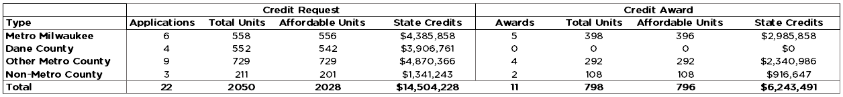
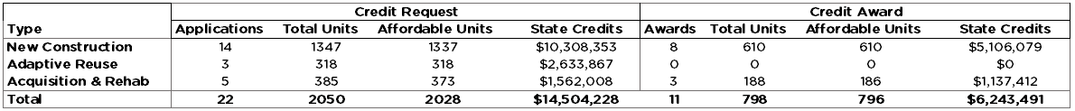
4% State Housing Tax Credits –
Location and Construction Type
By Location:
By Construction Type:

Slide 9
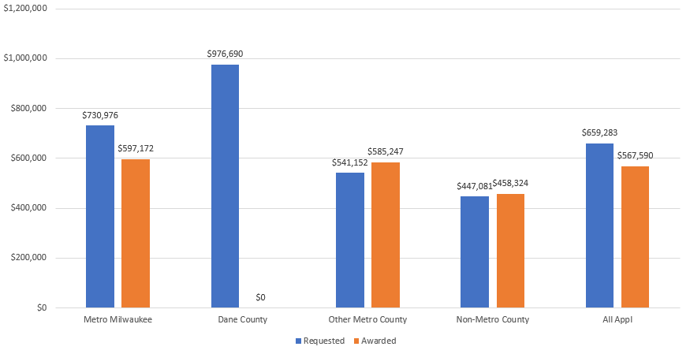
Average Tax Credit Requested vs. Awarded 4% State HTC - Location

Slide 10
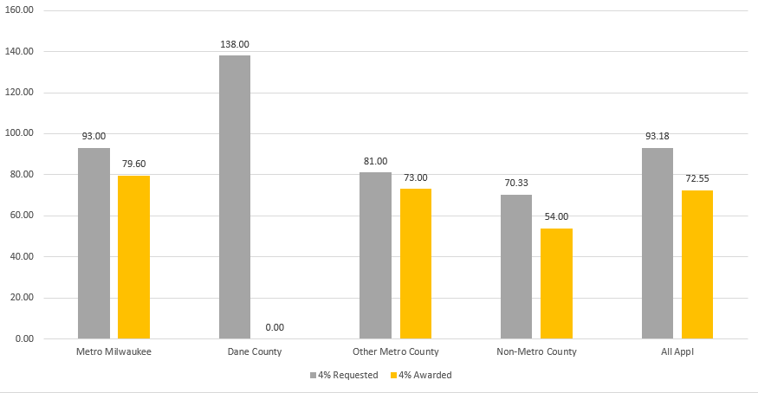
Average Project Size Requested vs. Awarded 4% State HTC - Location

Slide 11
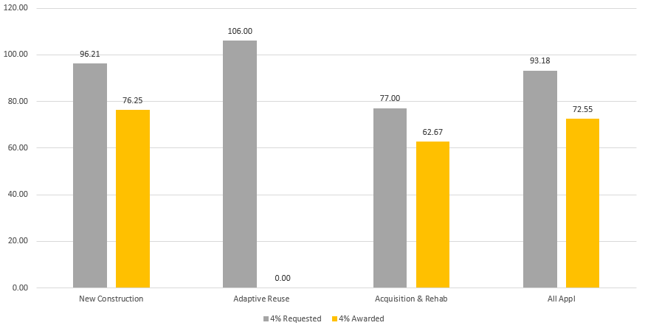
Average Project Size Requested vs. Awarded 4% State HTC – Construction Type

Slide 12
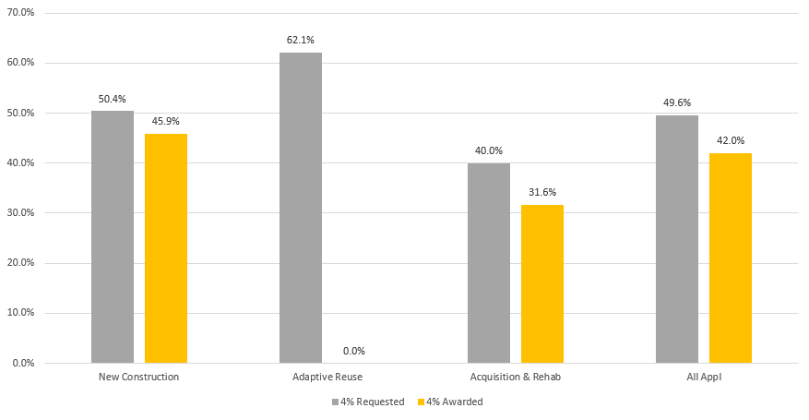
Average Deferred Developer Fee Requested vs. Awarded 4% State HTC – Construction Type

Slide 13
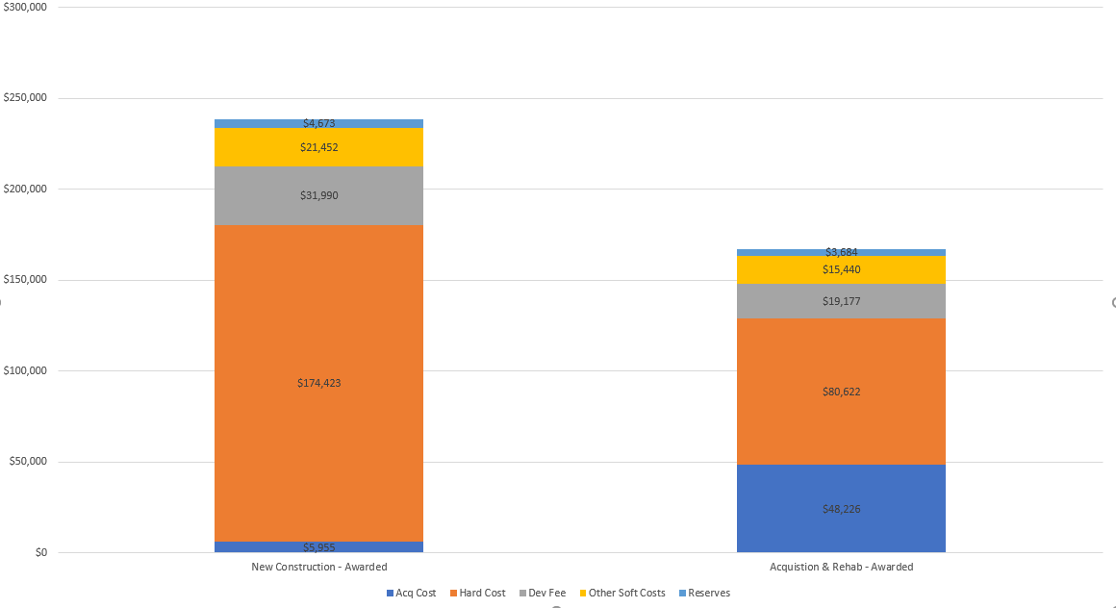
Per-Affordable Unit Development Budget – State 4% HTC Awarded Projects Construction Type

Slide 14
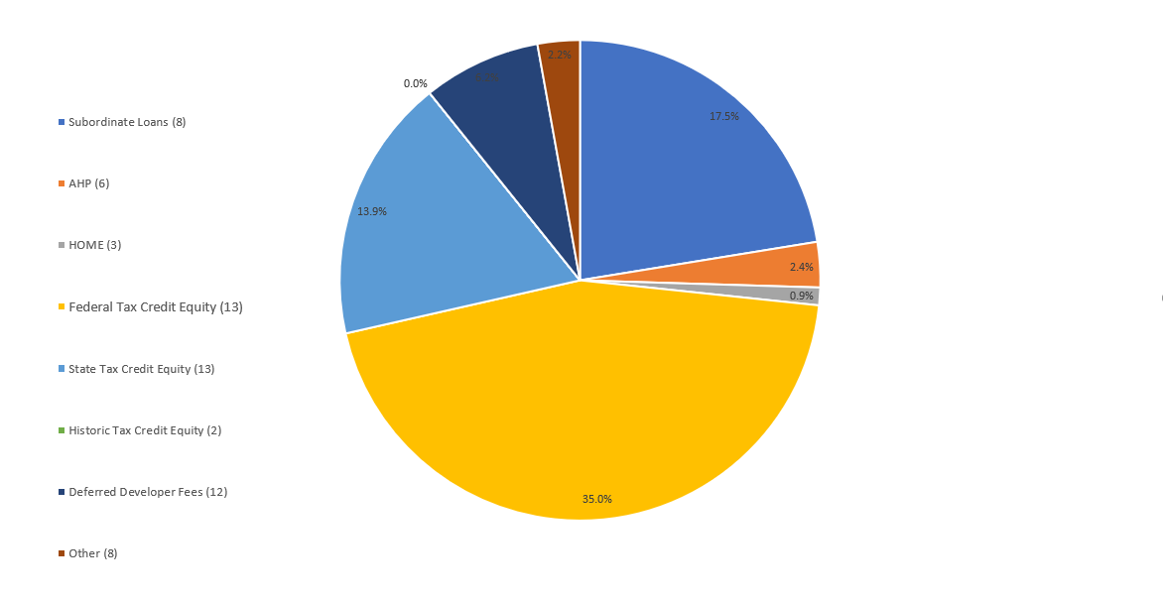
Proposed Capital Sources State 4% HTC Awarded Projects

